Slide 1
Predicting House prices using machine learning
TEAM MEMBER
963321106701 : SUDHA E
Phase 5 submission document
Project Title: House Price Predictor
Phase 5: Project Documentation & Submission
Topic: In this section we will document the complete project and prepare it for submission.

Slide 2
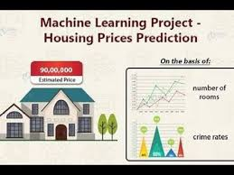

Slide 3
House Price Prediction
Introduction:
The real estate market is a dynamic and complex arena, where property values can fluctuate significantly due to a multitude of factors. For both homebuyers and sellers, accurately determining the fair market value of a property is of paramount importance.
In this era of technological advancement, machine learning has emerged as a game-changing tool in the realm of real estate. One of its most compelling applications is predicting house prices with remarkable accuracy.

Slide 4
Traditional methods of property valuation, relying on factors such as location, square footage, and recent sales data, are undoubtedly useful. However, they often fall short in capturing the intricacies and nuances that drive real estate market dynamics.
Machine learning, on the other hand, has the capability to process vast volumes of data and identify patterns that human appraisers might overlook. This technology has the potential to revolutionize the way we value real estate, offering more precise and data-driven predictions.

Slide 5
In this exploration, we delve into the exciting world of predicting house prices using machine learning. We will uncover how this cutting-edge technology harnesses the power of algorithms and data to create predictive models that consider an array of variables, such as neighborhood characteristics, property features, economic indicators, and even social trends.
By doing so, machine learning enables us to make informed, data backed predictions about the future value of a property.

Slide 6
This transformation of the real estate industry is not only beneficial for buyers and sellers but also for investors, developers, and policymakers. Accurate house price predictions can inform investment decisions, urban planning, and housing policy development, leading to a more efficient and equitable real estate market.
As we embark on this journey into the realm of machine learning for house price prediction, we will explore the various techniques, data sources, and challenges involved.

Slide 7
Dataset Link:
https://www.kaggle.com/datasets/vedavyasv/usa-housing

Slide 8
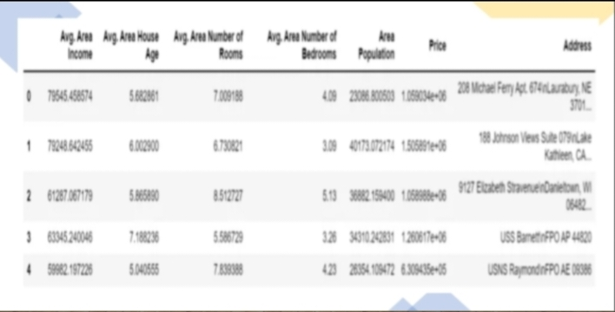
Given data set:

Slide 9
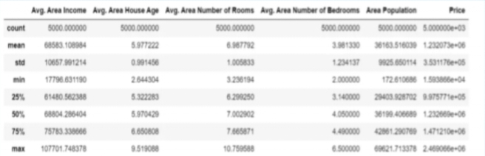

Slide 10
Here's a list of tools and software commonly used in the process:
Programming Language:
Python is the most popular language for machine learning due to its extensive libraries and frameworks. You can use libraries like NumPy,pandas, scikit-learn, and more.
2. Integrated Development Environment (IDE):
Choose an IDE for coding and running machine learning experiments. Some popular options include Jupyter Notebook, Google Colab, or traditional IDEs like PyCharm.

Slide 11
3. Machine Learning Libraries:
-You'll need various machine learning libraries, including:
- scikit-learn for building and evaluating machine learning models.
- TensorFlow or PyTorch for deep learning, if needed.
- XGBoost, LightGBM, or CatBoost for gradient boosting models
4. Data Visualization Tools:
Tools like Matplotlib, Seaborn, or Plotly are essential for data
exploration and visualization.

Slide 12
5. Data Preprocessing Tools:
Libraries like pandas help with data cleaning, manipulation, and Preprocessing
6. Data Collection and Storage:
Depending on your data source, you might need web scraping tools (e.g., BeautifulSoup or Scrapy) or databases (e.g., SQLite,PostgreSQL) for data storage.
7. Version Control:
Version control systems like Git are valuable for tracking changes in your code and collaborating with others.

Slide 13
8. Notebooks and Documentation:
Tools for documenting your work, such as Jupyter Notebooks or Markdown for creating README files and documentation.
9. Hyperparameter Tuning:
Tools like GridSearchCV or RandomizedSearchCV from scikit-learn can help with hyperparameter tuning.
10. Web Development Tools (for Deployment):
If you plan to create a web application for model deployment,knowledge of web development tools like Flask or Django for backend development, and HTML, CSS, and JavaScript for the front-end can be useful.

Slide 14
11. Cloud Services (for Scalability):
For large-scale applications, cloud platforms like AWS, Google Cloud, or Azure can provide scalable computing and storage resources.
12. External Data Sources (if applicable):
Depending on your project's scope, you might require tools to access external data sources, such as APIs or data scraping tools.
13. Data Annotation and Labeling Tools (if applicable):
For specialized projects, tools for data annotation and labeling may be necessary, such as Labelbox or Supervisely.

Slide 15

14. Geospatial Tools (for location-based features):
If your dataset includes geospatial data, geospatial libraries like GeoPandas can be helpful.

Slide 16
1.DESIGN THINKING AND PRESENT IN FORM OF DOCUMENT
1.Empathize:
Understand the needs and challenges of all stakeholders involved in the house price prediction process, including homebuyers, sellers,real estate professionals, appraisers, and investors.
Conduct interviews and surveys to gather insights on what users value in property valuation and what information is most critical for their decision-making.

Slide 17
2.Define:
Clearly articulate the problem statement, such as "How might we predict house prices more accurately and transparently using machine learning?"
Identify the key goals and success criteria for the project, such as increasing prediction accuracy, reducing bias, or improving user trust in the valuation process.
3.Ideate:
Brainstorm creative solutions and data sources that can enhance the accuracy and transparency of house price predictions.
Encourage interdisciplinary collaboration to generate a wide range of ideas, including the use of alternative data, new algorithms, or improved visualization techniques.

Slide 18
4.Prototype:
Create prototype machine learning models based on the ideas generated during the ideation phase.
Test and iterate on these prototypes to determine which approaches are most promising in terms of accuracy and usability.
5.Test:
Gather feedback from users and stakeholders by testing the machine learning models with real-world data and scenarios.
Assess how well the models meet the defined goals and success criteria, and make adjustments based on user feedback.

Slide 19
6.Implement:
Develop a production-ready machine learning solution for predicting house prices, integrating the best-performing algorithms and data sources.
Implement transparency measures, such as model interpretability tools, to ensure users understand how predictions are generated.
7.Evaluate:
Continuously monitor the performance of the machine learning model after implementation to ensure it remains accurate and relevant in a changing real estate market.
Gather feedback and insights from users to identify areas for improvement.

Slide 20
8.Iterate:
Apply an iterative approach to refine the machine learning model based on ongoing feedback and changing user needs.
Continuously seek ways to enhance prediction accuracy,transparency, and user satisfaction.
9.Scale and Deploy:
Once the machine learning model has been optimized and validated,deploy it at scale to serve a broader audience, such as real estate professionals, investors, and homeowners.
Ensure the model is accessible through user-friendly interfaces and integrates seamlessly into real estate workflows.

Slide 21
10.Educate and Train:
Provide training and educational resources to help users understand how the machine learning model works, what factors it considers,and its limitations.
Foster a culture of data literacy among stakeholders to enhance trust in the technology.

Slide 22
2.DESIGN INTO INNOVATION
Data Collection:
Gather a comprehensive dataset that includes features such as location, size, age, amenities, nearby schools, crime rates, and other relevant variables.
2.Data Preprocessing:
Clean the data by handling missing values, outliers, and encoding categorical variables. Standardize or normalize numerical features as necessary

Slide 23
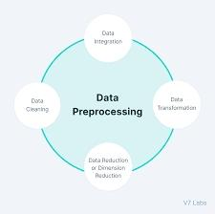

Slide 24
PYHON PROGRAM:
Import necessary libraries
import pandas as pd
from sklearn.preprocessing import LabelEncoder
from sklearn.model_selection import train_test_split
from sklearn.impute import SimpleImputer
from sklearn.preprocessing import StandardScaler

Slide 25
# Load the dataset (replace 'house_data.csv' with your dataset file)
data = pd.read_csv('E:/USA_Housing.csv')
# Display the first few rows of the dataset to get an overview
print("Dataset Preview:")
print(data.head())
# Data Pre-processing
# Handle Missing Values
# Let's fill missing values in numeric columns with the mean and in
categorical columns with the most frequent value.
numeric_cols = data.select_dtypes(include='number').columns
categorical_cols = data.select_dtypes(exclude='number').columns

Slide 26
imputer_numeric = SimpleImputer(strategy='mean')
imputer_categorical = SimpleImputer(strategy='most_frequent’)
data[numeric_cols] =
imputer_numeric.fit_transform(data[numeric_cols])
data[categorical_cols] =
imputer_categorical.fit_transform(data[categorical_cols])
# Convert Categorical Features to Numerical
# We'll use Label Encoding for simplicity here. You can also use one-
hot encoding for nominal categorical features.
label_encoder = LabelEncoder()
for col in categorical_cols:
data[col] = label_encoder.fit_transform(data[col])

Slide 27
# Split Data into Features (X) and Target (y)
X = data.drop(columns=['Price']) # Features
y = data['Price'] # Target
# Normalize the Data
scaler = StandardScaler()
X_scaled = scaler.fit_transform(X)
# Split data into training and testing sets (adjust test_size as needed)
X_train, X_test, y_train, y_test = train_test_split(X_scaled, y,
test_size=0.2, random_state=42)

Slide 28
# Display the preprocessed data
print("\nPreprocessed Data:")
print(X_train[:5]) # Display first 5 rows of preprocessed features
print(y_train[:5]) # Display first 5 rows of target values

Slide 29
OUTPUT:
Dataset Preview:
Avg. Area Income Avg. Area House Age Avg. Area Number of Roo
ms \
0 79545.458574 5.682861 7.009188
1 79248.642455 6.002900 6.730821
2 61287.067179 5.865890 8.512727
3 63345.240046 7.188236 5.586729
4 59982.197226 5.040555 7.839388
Avg. Area Number of Bedrooms Area Population Price \
0 4.09 23086.800503 1.059034e+06
1 3.09 40173.072174 1.505891e+06
2 5.13 36882.159400 1.058988e+06

Slide 30
3 3.26 34310.242831 1.260617e+06
4 4.23 26354.109472 6.309435e+05
Address
0 208 Michael Ferry Apt. 674\nLaurabury, NE 3701...
1 188 Johnson Views Suite 079\nLake Kathleen, CA...
2 9127 Elizabeth Stravenue\nDanieltown, WI 06482...
3 USS Barnett\nFPO AP 44820
4 USNS Raymond\nFPO AE 09386

Slide 31
Preprocessed Data:
[[-0.19105816 -0.13226994 -0.13969293 0.12047677 -0.83757985 -1.0
0562872]
[-1.39450169 0.42786736 0.79541275 -0.55212509 1.15729018 1.61
946754]
[-0.35137865 0.46394489 1.70199509 0.03133676 -0.32671213 1.63
886651]
[-0.13944143 0.1104872 0.22289331 -0.75471601 -0.90401197 -1.54
810704]
[ 0.62516685 2.20969666 0.42984356 -0.45488144 0.12566216 0.98
830821]]
4227 1.094880e+06
4676 1.300389e+06

Slide 32
800 1.382172e+06
3671 1.027428e+06
4193 1.562887e+06
Name: Price, dtype: float64

Slide 33
3.Feature Engineering:
Create new features or transform existing ones to extract more valuable information. For example, you can calculate the distance to the nearest public transportation, or create a feature for the overall condition of the house
4.Model Selection:
Choose the appropriate machine learning model for the task.Common models for regression problems like house price prediction include Linear Regression, Decision Trees, Random Forest, Gradient Boosting, and Neural Networks.

Slide 34
5. Training:
Split the dataset into training and testing sets to evaluate the model's performance. Consider techniques like cross-validation to prevent overfitting.
6. Hyperparameter Tuning:
Optimize the model's hyperparameters to improve its predictive accuracy. Techniques like grid search or random search can help with this.
7.Evaluation Metrics:
Select appropriate evaluation metrics for regression tasks, such as Mean Absolute Error (MAE), Mean Squared Error (MSE), or Root Mean Squared Error (RMSE). Choose the metric that aligns with the specific objectives of your project.

Slide 35
8.Regularization:
Apply regularization techniques like L1 (Lasso) or L2 (Ridge) regularization to prevent overfitting.
9.Feature Selection:
Use techniques like feature importance scores or recursive feature elimination to identify the most relevant features for the prediction
10. Interpretability:
Ensure that the model's predictions are interpretable and explainable. This is especially important for real estate applications where stakeholders want to understand the factors affecting predictions.

Slide 36
11. Deployment:
Develop a user-friendly interface or API for end-users to input property details and receive price predictions.
12. Continuous Improvement:
Implement a feedback loop for continuous model improvement based on user feedback and new data.
13. Ethical Considerations:
Be mindful of potential biases in the data and model. Ensure fairness and transparency in your predictions.

Slide 37
14. Monitoring and Maintenance:
Regularly monitor the model's performance in the real world and update it as needed.
15. Innovation:
Consider innovative approaches such as using satellite imagery or IoT data for real-time property condition monitoring, or integrating natural language processing for textual property descriptions.

Slide 38


Slide 39
3.BUILD LOADING AND PREPROCESSING THE DATASET
Data Collection:
Obtain a dataset that contains information about houses and their corresponding prices. This dataset can be obtained from sources like real estate websites, government records, or other reliable data providers
2. Load the Dataset:
Import relevant libraries, such as pandas for data manipulation and numpy for numerical operations.

Slide 40
Load the dataset into a pandas DataFrame for easy data handling.You can use pd.read_csv() for CSV files or other appropriate functions for different file formats.
Program:
import pandas as pd
import numpy as np
import seaborn as sns
import matplotlib.pyplot as plt
from sklearn.model_selection import train_test_split
from sklearn.preprocessing import StandardScaler

Slide 41
from sklearn.metrics import r2_score,
mean_absolute_error,mean_squared_error
from sklearn.linear_model import LinearRegression
from sklearn.linear_model import Lasso
from sklearn.ensemble import RandomForestRegressor
from sklearn.svm import SVR
import xgboost as xg
%matplotlib inline
import warnings
warnings.filterwarnings("ignore")
/opt/conda/lib/python3.10/site-packages/scipy/__init__.py:146:
UserWarning: A NumPy version >=1.16.5 and <1.23.0 is required for
this version of SciPy (detected version 1.23.5
warnings.warn(f"A NumPy version >={np_minversion} and <{np_maxversion}”

Slide 42
Loading Dataset:
dataset = pd.read_csv('E:/USA_Housing.csv’)
Output:

Slide 43
3. Data Exploration:
Explore the dataset to understand its structure and contents.Check for the presence of missing values, outliers, and data types of each feature.
4. Data Cleaning:
Handle missing values by either removing rows with missing data or imputing values based on the nature of the data.
5. Feature Selection:
Identify relevant features for house price prediction. Features like the number of bedrooms, square footage, location, and amenities are often important.

Slide 44
We are selecting numerical features which have more than 0.50 or less than -0.50 correlation rate based on Pearson Correlation Method—which is the default value of parameter "method" in corr() function. As for selecting categorical features, I selected the categorical values which I believe have significant effect on the target variable such as Heating and MSZoning.
In [1]:
important_num_cols = list(df.corr()["SalePrice"][(df.corr()["SalePrice"]>0.5
0) | (df.corr()["SalePrice"]<-0.50)].index)
cat_cols = ["MSZoning", "Utilities","BldgType","Heating","KitchenQual"," SaleCondition","LandSlope"]
important_cols = important_num_cols + cat_cols
df = df[important_cols]
Checking for the missing values

Slide 45
In [2]:
print("Missing Values by Column")
print("-"*30)
print(df.isna().sum())
print("-"*30)
print("TOTAL MISSING VALUES:",df.isna().sum().sum())
Missing Values by Column
------------------------------
OverallQual 0
YearBuilt 0
YearRemodAdd 0

Slide 46
TotalBsmtSF 0
1stFlrSF 0
GrLivArea 0
FullBath 0
TotRmsAbvGrd 0
GarageCars 0
GarageArea 0
SalePrice 0
MSZoning 0

Slide 47
Utilities 0
BldgType 0
Heating 0
KitchenQual 0
SaleCondition 0
LandSlope 0
dtype: int64
------------------------------
TOTAL MISSING VALUES: 0

Slide 48
6. Feature Engineering:
Create new features or transform existing ones to capture additional information that may impact house prices. For example, you can calculate the price per square foot.
7. Data Encoding:
Convert categorical variables (e.g., location) into numerical format using techniques like one-hot encoding.
8. Train-Test Split:
Split the dataset into training and testing sets to evaluate the machine learning model's performance.

Slide 49
Program:
X = df.drop('price', axis=1) # Features
y = df['price'] # Target variable
X_train, X_test, y_train, y_test = train_test_split(X, y,
test_size=0.2, random_state=42)

Slide 50
4.PERFORMING DIFFERENT ACTIVITIES LIKE FEATURE ENGINEERING, MODEL TRAINING,EVALUATION etc.,
Feature Engineering:
As mentioned earlier, feature engineering is crucial. It involves creating new features or transforming existing ones to provide meaningful information for your model.
Extracting information from textual descriptions (e.g., presence of keywords like "pool" or "granite countertops").
Calculating distances to key locations (e.g., schools, parks) if you have location data.

Slide 51
2. Data Preprocessing & Visualisation:
Continue data preprocessing by handling any remaining missing values or outliers based on insights from your data exploration.
Visualisation and Pre-Processing of Data:
In [1]:
sns.histplot(dataset, x='Price', bins=50, color='y’)
Out[1]:
<Axes: xlabel='Price', ylabel='Count'>

Slide 52
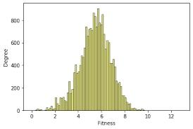

Slide 53
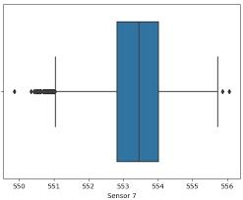
In [2]:
sns.boxplot(dataset, x='Price', palette='Blues’)
Out[2]:
<Axes: xlabel='Price’>

Slide 54
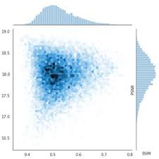
In [3]:
sns.jointplot(dataset, x='Avg. Area House Age', y='Price', kind='hex’)
Out[3]:
<seaborn.axisgrid.JointGrid at 0x7caf1d571810>

Slide 55
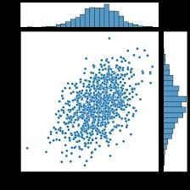
In [4]:
sns.jointplot(dataset, x='Avg. Area Income', y='Price’)
Out[4]:
<seaborn.axisgrid.JointGrid at 0x7caf1d8bf7f0>

Slide 56
In [5]:
plt.figure(figsize=(12,8))sns.pairplot(dataset)
Out[5]:
<seaborn.axisgrid.PairGrid at 0x7caf0c2ac550>
<Figure size 1200x800 with 0 Axes>

Slide 57
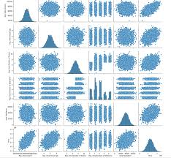

Slide 58
In [6]:
dataset.hist(figsize=(10,8))
Out[6]:
array([[<Axes: title={'center': 'Avg. Area Income’}>,
<Axes: title={'center': 'Avg. Area House Age'}>],
[<Axes: title={'center': 'Avg. Area Number of Rooms'}>,
<Axes: title={'center': 'Avg. Area Number of Bedrooms'}>],
[<Axes: title={'center': 'Area Population'}>,
<Axes: title={'center': 'Price'}>]], dtype=object)

Slide 59
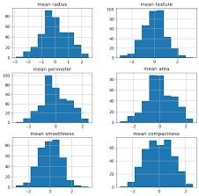

Slide 60
Visualising Correlation:
In [7]:
dataset.corr(numeric_only=True)
Out[7]:

Slide 61
Avg.
Area
Income
Avg.
Area
House
Age
Avg.
Area
Number
of
Rooms
Avg. Area
Number
of
Bedrooms
Area
Population Price
Avg. Area
Income 1.000000 -0.002007
-0.011032 0.019788 -0.016234 0.639734

Slide 62
Avg. Area
House
Age
-0.002007 1.000000 -0.009428 0.006149 -0.018743 0.452543
Avg. Area
Number of
Rooms
-0.011032
-0.009428 1.000000 0.462695 0.002040 0.335664
Avg. Area
Number of
Bedrooms
0.019788 0.006149 0.462695 1.000000 -0.022168 0.171071
Area
Population
-0.016234
-0.018743 0.002040 -0.022168 1.000000 0.408556
Price 0.639734 0.452543 0.335664 0.171071 0.408556 1.000000

Slide 63
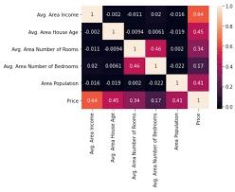
In [8]:
plt.figure(figsize=(10,5))sns.heatmap(dataset.corr(numeric_only = Tru
e), annot=True)
Out[8]:
<Axes: >

Slide 64
3. Model Selection:
Choose an appropriate machine learning model for your regression task. Common choices include:
Linear Regression
Decision Trees
Random Forest
Gradient Boosting (e.g., XGBoost or LightGBM)
Neural Networks (Deep Learning)

Slide 65
Program:
Importing Dependencies
import pandas as pd
import numpy as np
import seaborn as sns
import matplotlib.pyplot as plt
from sklearn.model_selection import train_test_split
from sklearn.preprocessing import StandardScaler
from sklearn.metrics import r2_score,
mean_absolute_error,mean_squared_error
from sklearn.linear_model import LinearRegression
from sklearn.linear_model import Lasso

Slide 66
from sklearn.ensemble import RandomForestRegressor
from sklearn.svm import SVR
import xgboost as xg
%matplotlib inline
import warnings
warnings.filterwarnings("ignore")
/opt/conda/lib/python3.10/site-packages/scipy/_init_.py:146:
UserWarning: A NumPy version >=1.16.5 and <1.23.0 is required
for this version of SciPy (detected version 1.23.5
warnings.warn(f"A NumPy version >={np_minversion} and
<{np_maxversion}"

Slide 67
Loading Dataset
dataset = pd.read_csv('E:/USA_Housing.csv’)
Model 1 - Linear Regression
In [1]:
model_lr=LinearRegression()
In [2]:
model_lr.fit(X_train_scal, Y_train)
Out[2]:

Slide 68


Slide 69
Predicting Prices
In [3]:
Prediction1 = model_lr.predict(X_test_scal)
Evaluation of Predicted Data
In [4]:
plt.figure(figsize=(12,6))
plt.plot(np.arange(len(Y_test)), Y_test, label='Actual Trend')
plt.plot(np.arange(len(Y_test)), Prediction1, label='Predicted Tr
end')

Slide 70
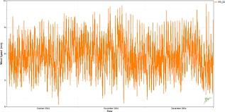
plt.xlabel('Data')
plt.ylabel('Trend')
plt.legend()
plt.title('Actual vs Predicted’)
Out[4]:
Text(0.5, 1.0, 'Actual vs Predicted’)

Slide 71
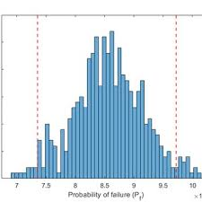
In [5]:
sns.histplot((Y_test-Prediction1), bins=50)
Out[5]:
<Axes: xlabel='Price', ylabel='Count’>

Slide 72
In [6]:
print(r2_score(Y_test, Prediction1))
print(mean_absolute_error(Y_test, Prediction1))
print(mean_squared_error(Y_test, Prediction1))
Out[6]:
0.9182928179392918
82295.49779231755
10469084772.975954

Slide 73

Model 2 - Support Vector Regressor
In [7]:
model_svr = SVR()
In [8]:
model_svr.fit(X_train_scal, Y_train)
Out[8]:

Slide 74
Predicting Prices
In [9]:
Prediction2 = model_svr.predict(X_test_scal)
Evaluation of Predicted Data
In [10]:
plt.figure(figsize=(12,6))
plt.plot(np.arange(len(Y_test)), Y_test, label='Actual Trend’)
plt.plot(np.arange(len(Y_test)), Prediction2, label='Predicted Tr
end')

Slide 75
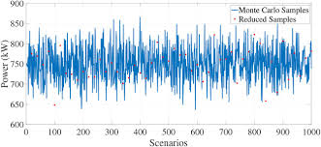
plt.xlabel('Data')
plt.ylabel('Trend')
plt.legend()
plt.title('Actual vs Predicted’)
Out[10]:
Text(0.5, 1.0, 'Actual vs Predicted')

Slide 76
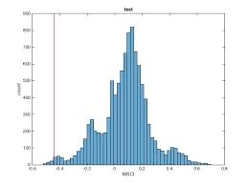
In [11]:
sns.histplot((Y_test-Prediction2), bins=50)
Out[12]:
<Axes: xlabel='Price', ylabel='Count’>

Slide 77
In [12]:
print(r2_score(Y_test, Prediction2))
print(mean_absolute_error(Y_test, Prediction2))
print(mean_squared_error(Y_test, Prediction2))
-0.0006222175925689744
286137.81086908665
128209033251.4034
Model 3 - Lasso Regression
In [13]:

Slide 78

model_lar = Lasso(alpha=1)
In [14]:
model_lar.fit(X_train_scal,Y_train)
Out[14]:

Slide 79
Predicting Prices
In [15]:
Prediction3 = model_lar.predict(X_test_scal)
Evaluation of Predicted Data
In [16]:
plt.figure(figsize=(12,6))
plt.plot(np.arange(len(Y_test)), Y_test, label='Actual Trend’)
plt.plot(np.arange(len(Y_test)), Prediction3, label='Predicted Tr
end')

Slide 80
plt.xlabel('Data')
plt.ylabel('Trend')
plt.legend()
plt.title('Actual vs Predicted’)
Out[16]:
Text(0.5, 1.0, 'Actual vs Predicted’)

Slide 81
In [17]:
sns.histplot((Y_test-Prediction3), bins=50)
Out[17]:
<Axes: xlabel='Price', ylabel='Count’>

Slide 82
In [18]:
print(r2_score(Y_test, Prediction2))
print(mean_absolute_error(Y_test, Prediction2))
print(mean_squared_error(Y_test, Prediction2))
-0.0006222175925689744
286137.81086908665
128209033251.4034
Model 4 - Random Forest Regressor
In [19]:

Slide 83

model_rf = RandomForestRegressor(n_estimators=50)
In [20]:
model_rf.fit(X_train_scal, Y_train)
Out[20]:

Slide 84
Predicting Prices
In [21]:
Prediction4 = model_rf.predict(X_test_scal)
Model 5 - XGboost Regressor
In [25]:
model_xg = xg.XGBRegressor()
In [26]:
model_xg.fit(X_train_scal, Y_train)

Slide 85
Out[26]:
XGBRegressor
XGBRegressor(base_score=None, booster=None,
callbacks=None,
colsample_bylevel=None, colsample_bynode=None,
colsample_bytree=None, early_stopping_rounds=None,
enable_categorical=False, eval_metric=None,
feature_types=None,
gamma=None, gpu_id=None, grow_policy=None,
importance_type=None,

Slide 86
interaction_constraints=None, learning_rate=None,
max_bin=None,
max_cat_threshold=None, max_cat_to_onehot=None,
max_delta_step=None, max_depth=None,
max_leaves=None,
min_child_weight=None, missing=nan,
monotone_constraints=None,
n_estimators=100, n_jobs=None,
num_parallel_tree=None,
predictor=None, random_state=None, ...)

Slide 87
4. Model Training:
Split your dataset into training and testing sets (as shown earlier) and train the selected model on the training data. Here's an example using Linear Regression:
5. Model Evaluation:
Evaluate your model's performance using appropriate regression metrics, such as Mean Absolute Error (MAE), Mean Squared Error(MSE), and Root Mean Squared Error (RMSE). For example:

Slide 88
PYTHON PROGRAM:
# Import necessary libraries
from sklearn.feature_selection import SelectKBest, f_regression
from sklearn.linear_model import LinearRegression
from sklearn.ensemble import RandomForestRegressor
from sklearn.metrics import mean_squared_error, r2_score
import numpy as np
selector = SelectKBest(score_func=f_regression, k=k)
X_train_selected = selector.fit_transform(X_train, y_train)

Slide 89
# Model Selection
# Let's choose both Linear Regression and Random Forest Regressor for
comparison.
linear_reg_model = LinearRegression()
random_forest_model = RandomForestRegressor(n_estimators=100,
random_state=42)
# Train the models on the selected features
linear_reg_model.fit(X_train_selected, y_train)
random_forest_model.fit(X_train_selected, y_train)

Slide 90
# Evaluate the models on the test set
X_test_selected = selector.transform(X_test)
# Make predictions
linear_reg_predictions = linear_reg_model.predict(X_test_selected)
random_forest_predictions =
random_forest_model.predict(X_test_selected)
# Evaluate model performance
def evaluate_model(predictions, model_name):
mse = mean_squared_error(y_test, predictions)
r2 = r2_score(y_test, predictions)

Slide 91
print(f"{model_name} Model Evaluation:")
print(f"Mean Squared Error (MSE): {mse}")
print(f"R-squared (R2) Score: {r2}\n")
# Performance Measure
elr_mse = mean_squared_error(y_test, pred)
elr_rmse = np.sqrt(lr_mse)
elr_r2 = r2_score(y_test, pred)
# Show Measures
result = '''
MSE : {}
RMSE : {}

Slide 92
R^2 : {}
'''.format(lr_mse, lr_rmse, lr_r2)
print(result)
# Model Comparision
names.append("elr")
mses.append(elr_mse)
rmses.append(elr_rmse)
r2s.append(elr_r2)
evaluate_model(linear_reg_predictions, "Linear Regression")
evaluate_model(random_forest_predictions, "Random Forest Regressor")

Slide 93
OUTPUT:
Linear Regression Model Evaluation:
Mean Squared Error (MSE): 10089009300.893988
R-squared (R2) Score: 0.9179971706834331
Random Forest Regressor Model Evaluation:
Mean Squared Error (MSE): 14463028828.265167
R-squared (R2) Score: 0.8824454166872736
MSE : 10141766848.330585
RMSE : 100706.33966305491
R^2 : 0.913302484308253

Slide 94
Model Comparison:
The less the Root Mean Squared Error (RMSE), The better the model is.
In [30]:
models.sort_values(by="RMSE (Cross-Validation)")
Out[30]:

Slide 95
Model MAE MSE RMSE R2 Score
RMSE
(Cross-
Validatio
n)
6 XGBRegressor 1.743992
e+04
7.165790
e+08
2.676899
e+04
9.065778
e-01
29698.84
9618

Slide 96
4 SVR 1.784316
e+04
1.132136
e+09
3.364723
e+04
8.524005
e-01
30745.47
5239

Slide 97
5 RandomForestRe
gressor
1.811511
e+04
1.004422
e+09
3.169262
e+04
8.690509
e-01
31138.86
3315

Slide 98
1 Ridge 2.343550
e+04
1.404264
e+09
3.747351
e+04
8.169225
e-01
35887.85
2792

Slide 99
2 Lasso 2.356046
e+04
1.414338
e+09
3.760768
e+04
8.156092
e-01
35922.76
9369

Slide 100
In [31]:
plt.figure(figsize=(12,8))
sns.barplot(x=models["Model"], y=models["RMSE (Cross-Validation)
"])
plt.title("Models' RMSE Scores (Cross-Validated)", size=15)
plt.xticks(rotation=30, size=12)
plt.show()

Slide 101
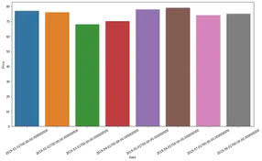

Slide 102
6. Hyperparameter Tuning:
Optimize the model's hyperparameters to improve its performance. Depending on the model, you can use techniques like grid search or random search.
7. Cross-Validation:
Implement cross-validation to ensure that your model’s performance is consistent across different subsets of your data. This helps prevent overfitting.
8. Regularization:
Apply regularization techniques like L1 (Lasso) or L2 (Ridge) if needed to prevent overfitting and improve model generalization.

Slide 103
Feature Selection:
Use feature importance scores from your model or techniques like recursive feature elimination to identify the most important features for predictions.
Interpretability:
Ensure that the model's predictions are interpretable and explainable. Stakeholders may want to understand how each feature impacts the predicted house price.

Slide 104
Deployment:
Deploy your trained model in a real-world setting, whether it’s through a web application, API, or any other user-friendly interface.Users can input property details, and the model provides price predictions.
Monitoring and Maintenance:
Continuously monitor the model's performance and update it as needed. Real estate markets change, so it's essential to retrain the model with new data periodically.

Slide 105
Ethical Considerations:
Ensure that your model doesn't introduce or perpetuate biases in pricing. Implement fairness and transparency measures
Innovation:
Explore innovative approaches such as incorporating external data sources (e.g., satellite imagery, IoT data) for better predictions.
ADVANTAGES:
Predicting house prices using machine learning offers several significant advantages

Slide 106
1.Accuracy:
Machine learning models can process and analyze vast amounts of data, including various property and market factors. This results in more accurate house price predictions compared to traditional methods that rely on a limited set of variables.
2.Complex Data Handling:
Machine learning algorithms can handle complex, non-linear relationships in the data. They can recognize patterns and interactions among different features, allowing for a more comprehensive assessment of a property's value.

Slide 107
3.Continuous Learning:
Machine learning models can be continually updated with new data, enabling them to adapt to changing market conditions and trends.This ensures that predictions remain relevant and up-to-date.
4.Efficiency:
Automated valuation models powered by machine learning can evaluate properties rapidly. This efficiency is beneficial for both property appraisers and individuals looking to determine the value of a property quickly.

Slide 108
5. Data Integration:
Machine learning models can incorporate a wide range of data sources, including property characteristics, neighborhood information,economic indicators, and even social trends. This holistic approach provides a more complete picture of the factors influencing house prices.
6.Reduced Bias:
Machine learning can help reduce human bias in property valuation. It evaluates properties objectively based on data, which can lead to fairer and more consistent pricing.

Slide 109
7.Market Insights:
By analyzing historical data and current market conditions,machine learning can offer valuable insights into market trends, helping investors and developers make informed decisions.
8.Risk Assessment:
Machine learning can assess the risk associated with a property, which is crucial for mortgage lenders and investors. It helps identify potential issues or opportunities related to a property's value.

Slide 110
9. Transparency:
Machine learning models can provide clear and transparent explanations for their predictions, which is essential for building trust among stakeholders in the real estate market.
10. Scalability:
Machine learning models can be deployed at scale, making it possible to assess property values in large real estate portfolios, entire neighborhoods, or even across entire cities.

Slide 111
11. Time and Cost Savings:
Using machine learning for property valuation can save time and reduce costs associated with manual appraisals, making it an efficient and cost-effective solution for both businesses and individuals.
12. Customization:
Machine learning models can be customized to cater to specific markets, types of properties, or regional variations, allowing for more tailored and precise predictions.

Slide 112

DISADVANTAGES:
While predicting house prices using machine learning offers numerous advantages, it also comes with several disadvantages and challenges:

Slide 113
1.Data Quality:
Machine learning models heavily rely on data quality. Inaccurate or incomplete data can lead to unreliable predictions. Ensuring the data used for training and evaluation is of high quality is essential.
2. Overfitting:
Machine learning models can be prone to overfitting, where they perform exceptionally well on the training data but struggle with new, unseen data. This can result in overly optimistic or inaccurate predictions.

